Slide 1
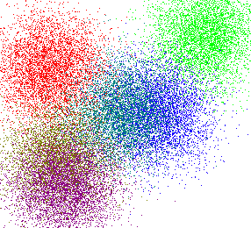
Data Mining :
Clustering

Slide 2
Learning Goals
What is Clustering
Hierarchical Clustering
K- Means Clustering
Notes:
2

Slide 3
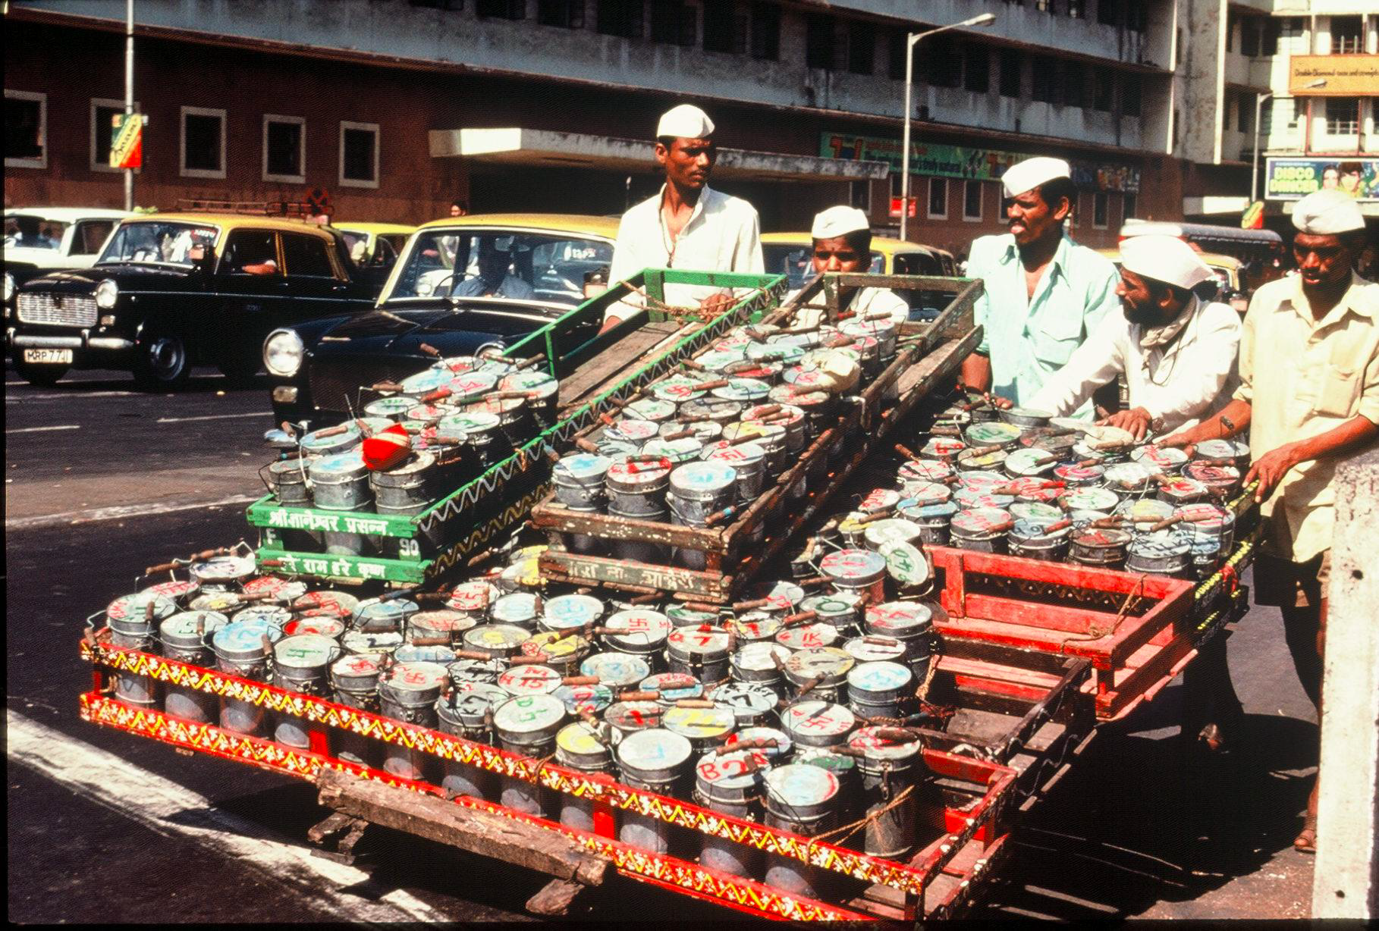

Slide 4
What is clustering?
Cluster Analysis (“data segmentation”) is an exploratory method for identifying homogenous groups (“clusters”) of records
Similar records should belong to the same cluster
Dissimilar records should belong to different clusters

Slide 5
So What and Why Clustering?
Clustering = Grouping “Similar” things together!
Understand/Discover structure in data
Summarize data points by their “Cluster center”

Slide 6
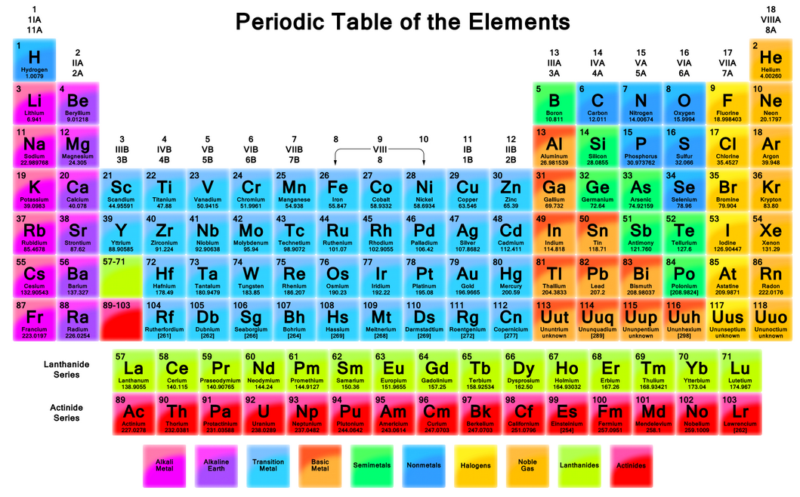
Nature is “naturally” organized

Slide 7
What Business questions can be answered?
Types of pages are there on the Web?
Types of customers are there in my market?
Types of people are there on a Social network?
Types of E-mails in my Inbox?
Types of Genes the human genome has?

Slide 8
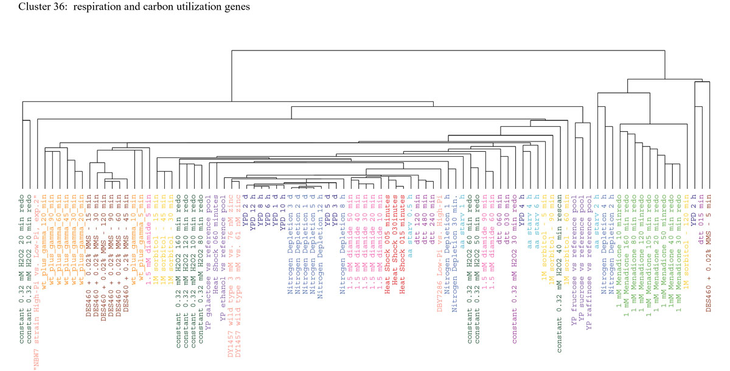
Clustering Genes

Slide 9
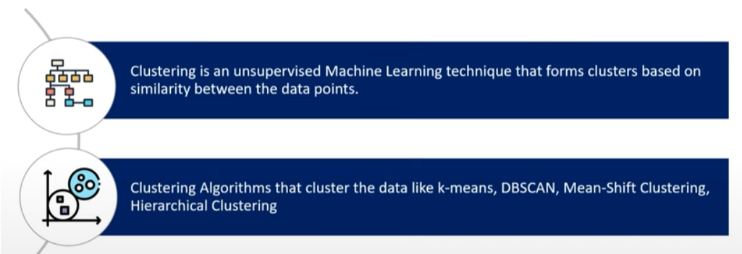
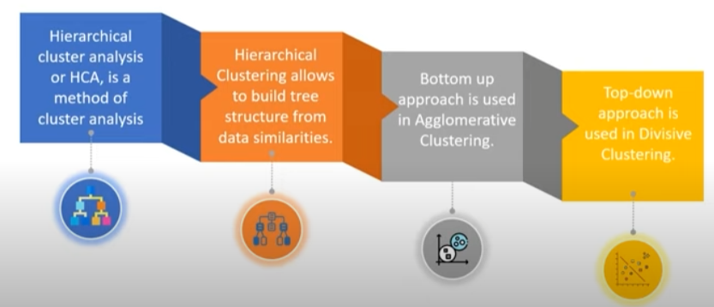

Slide 10
Hierarchical Clustering Agglomerative Clustering

Slide 11
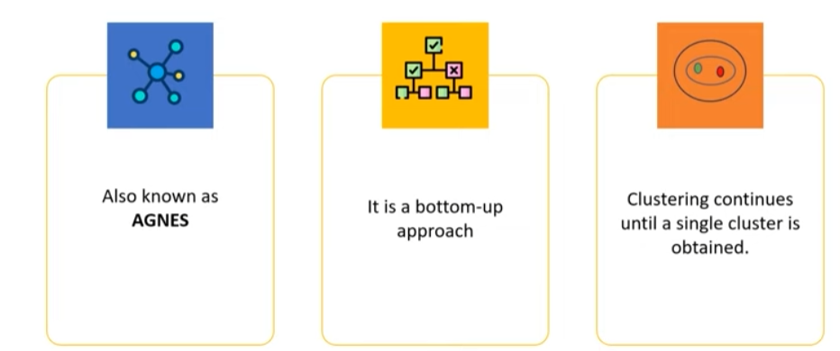
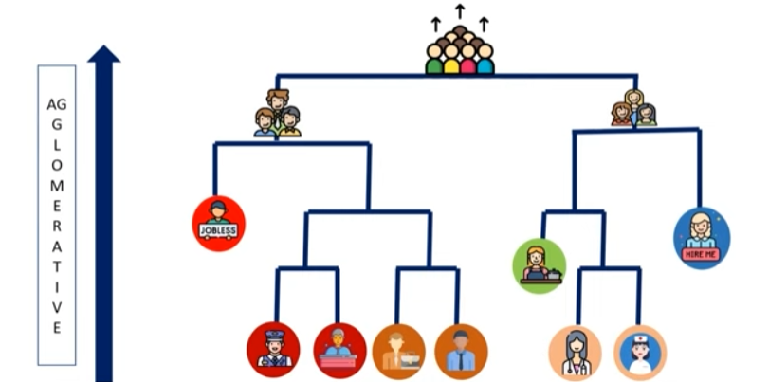

Slide 12
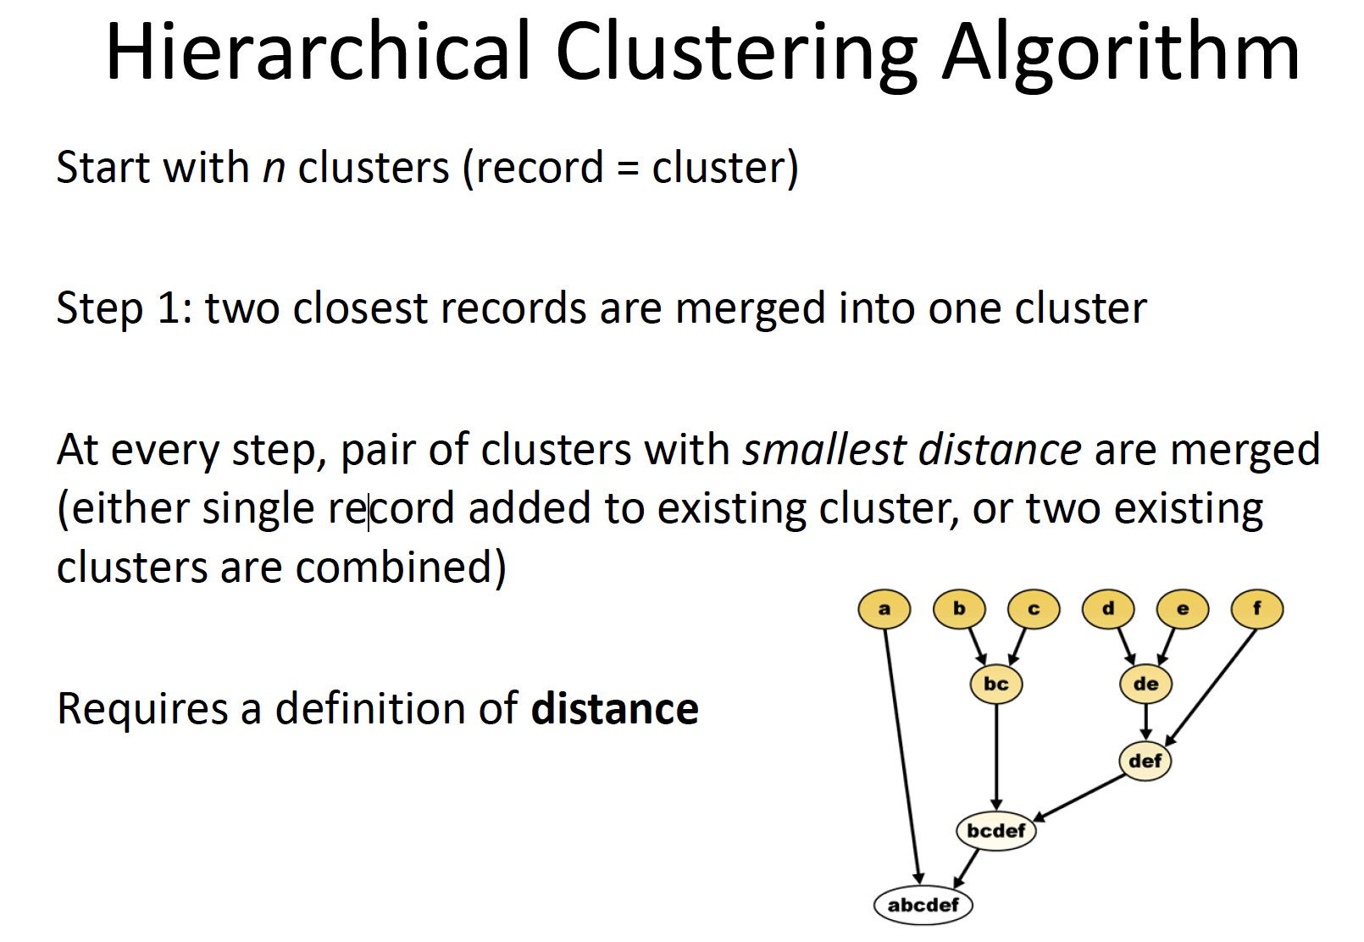

Slide 13
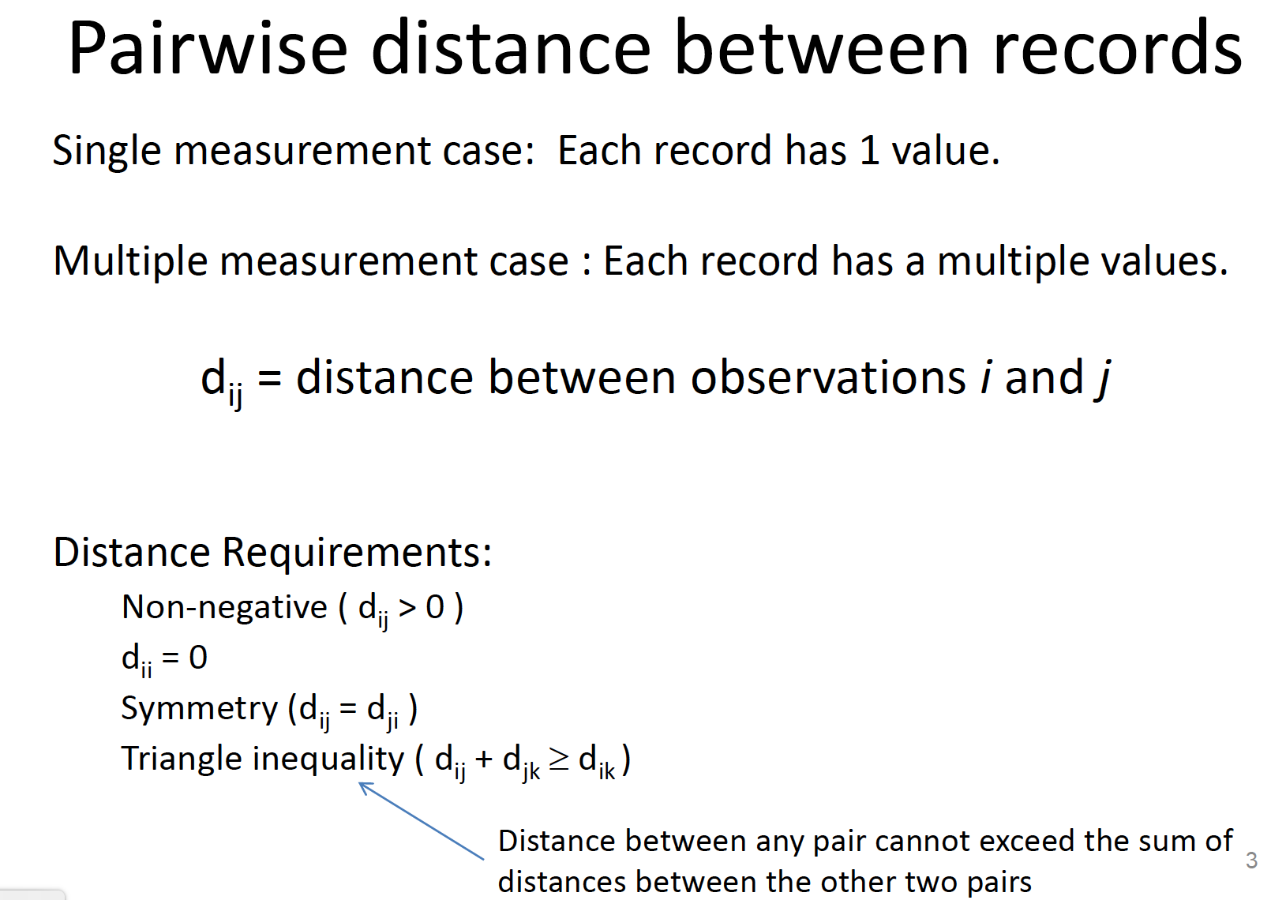

Slide 14
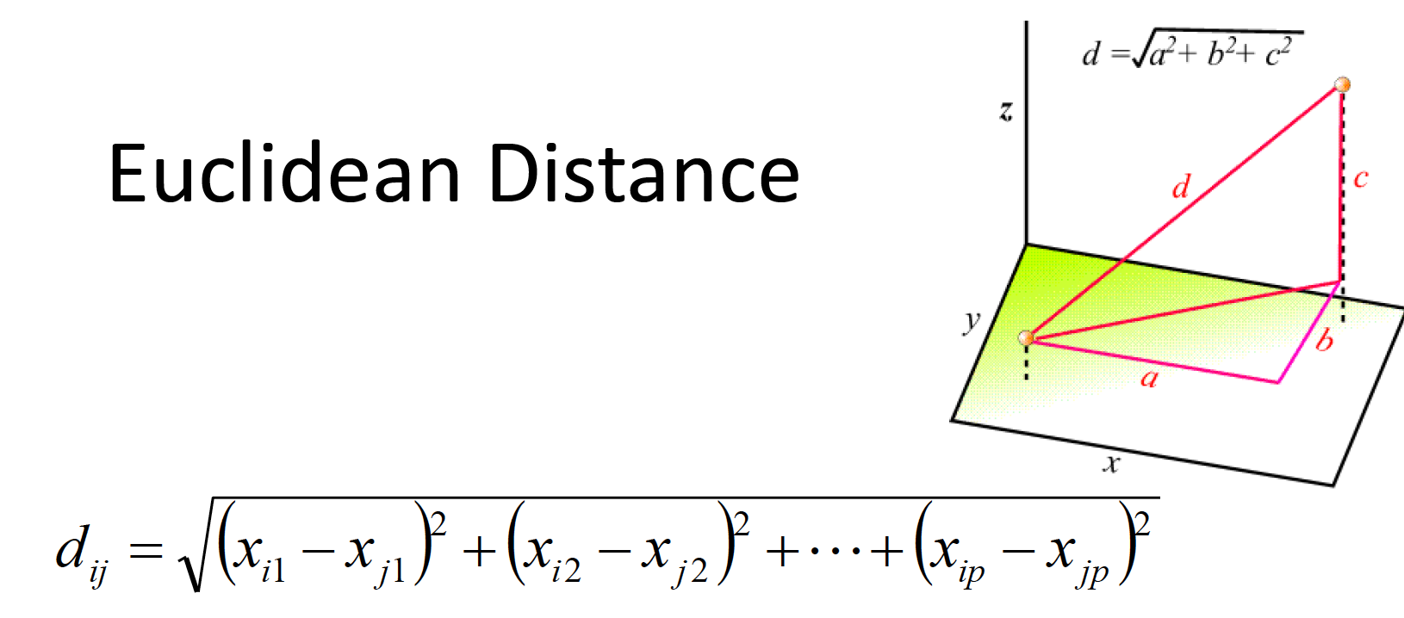

Slide 15
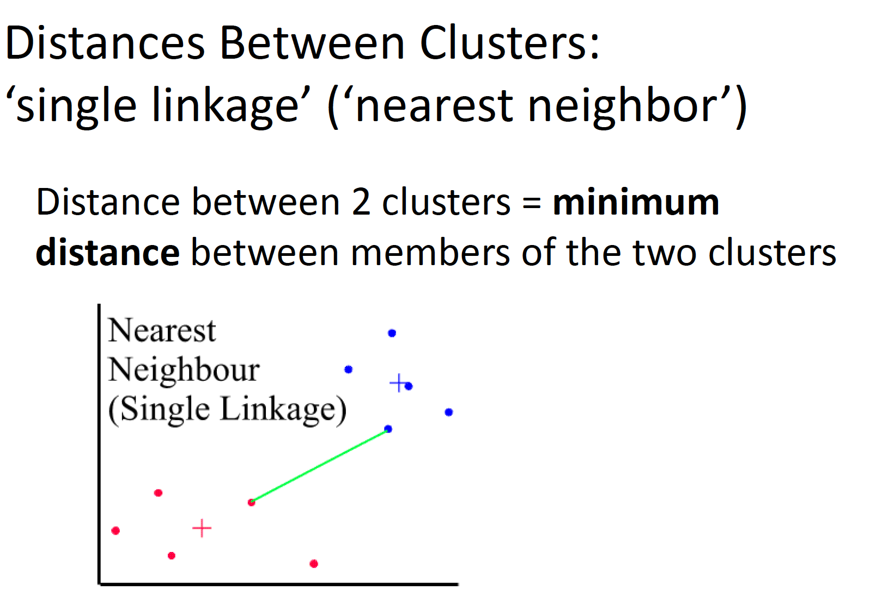
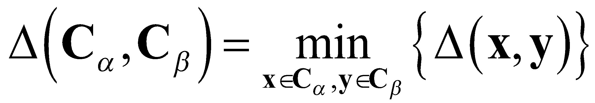

Slide 16
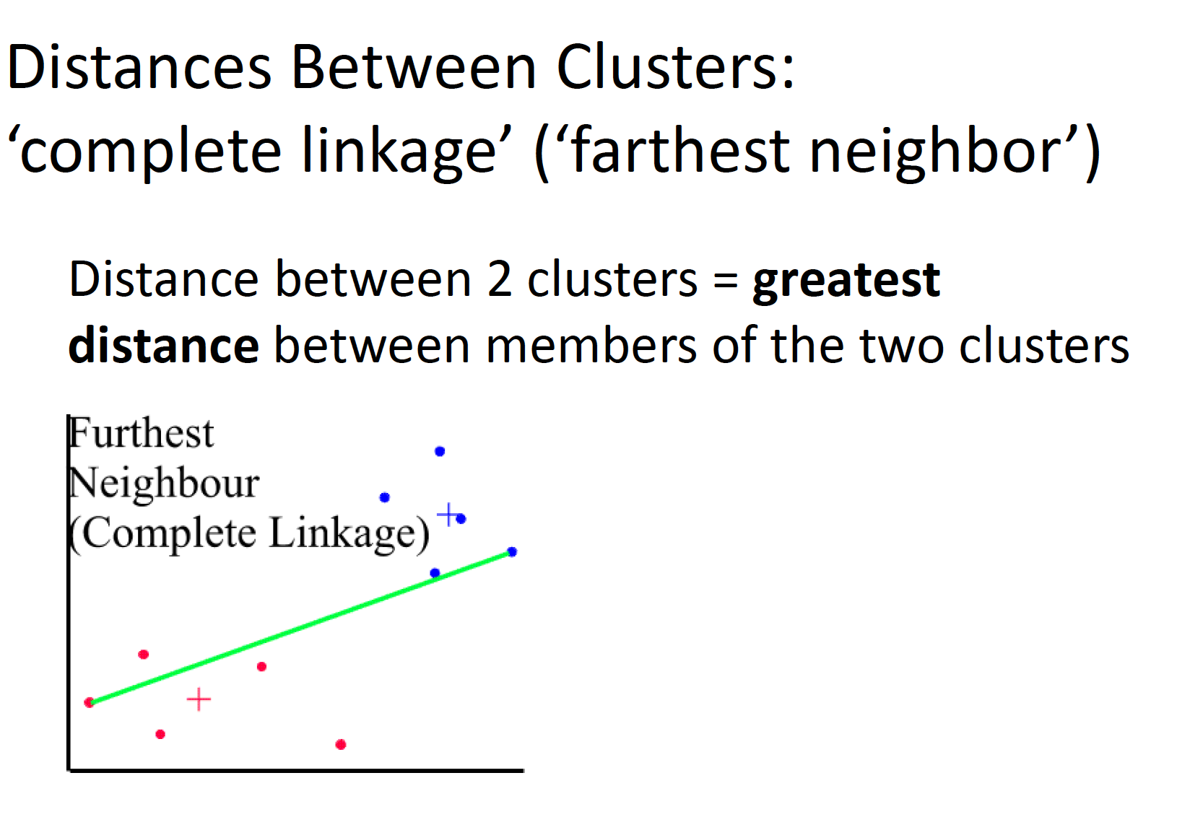
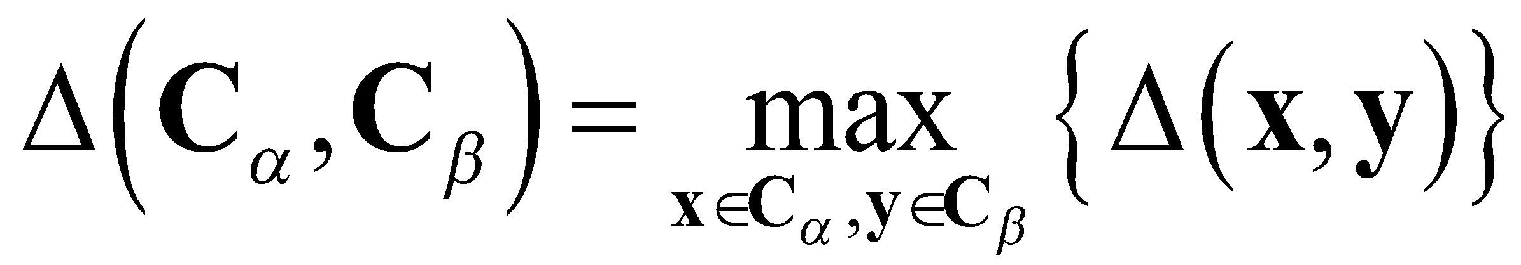

Slide 17
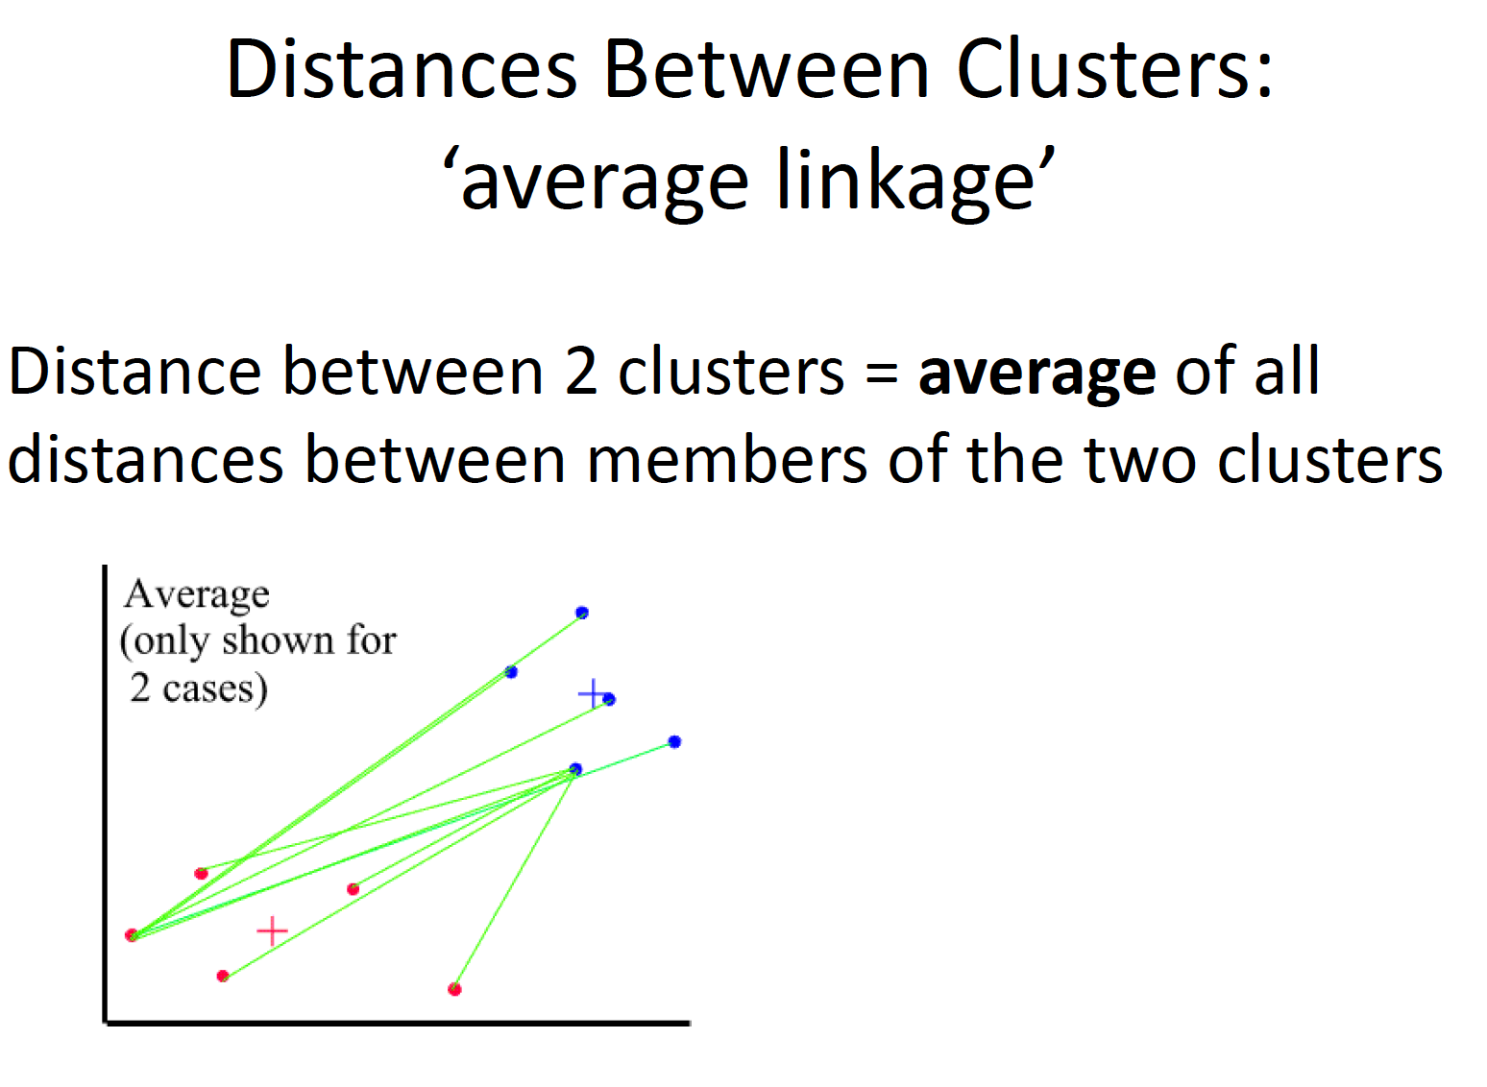
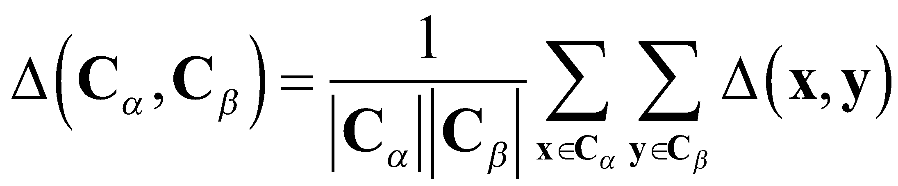

Slide 18
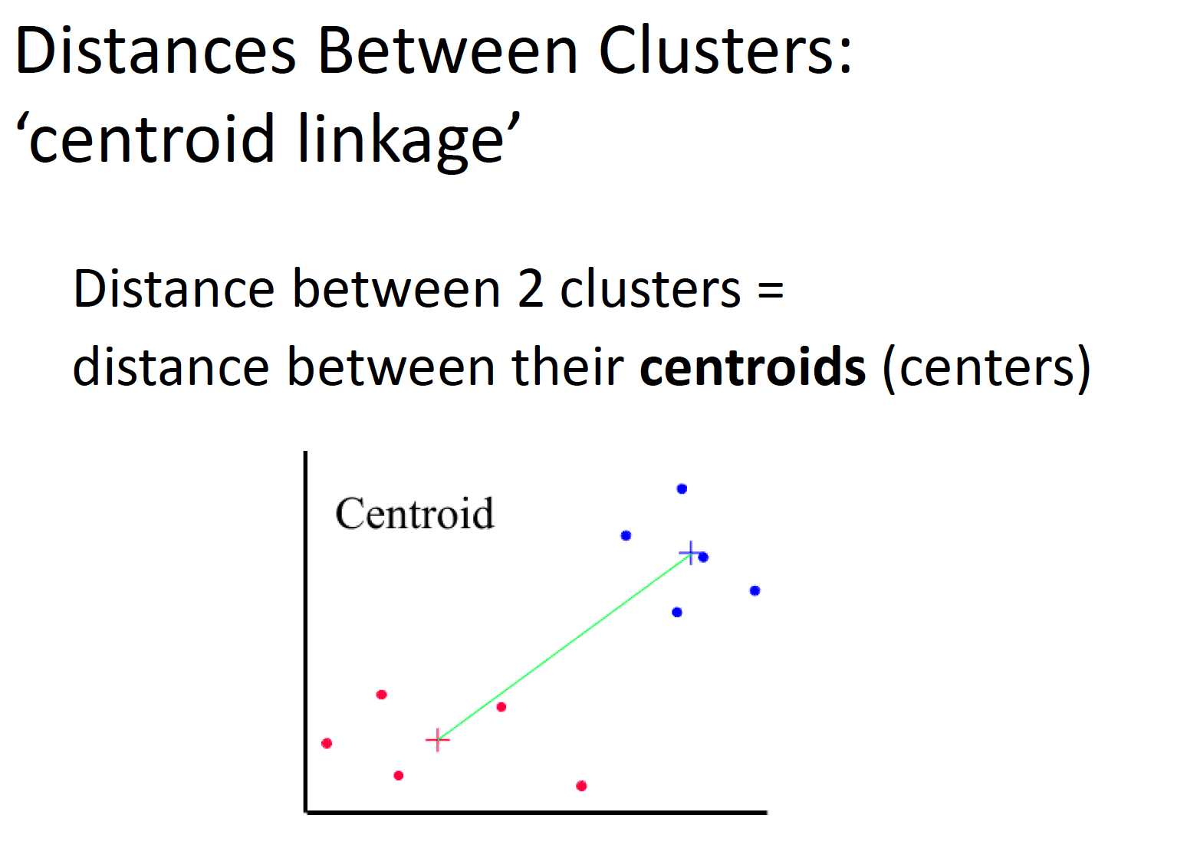
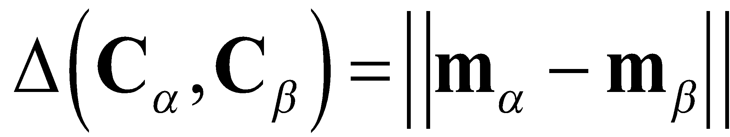

Slide 19
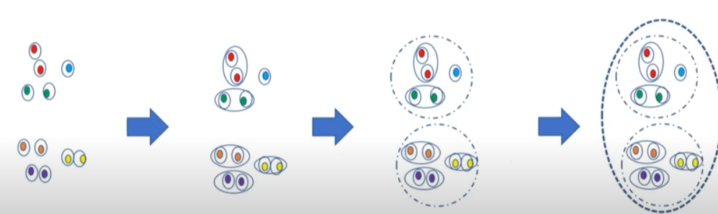
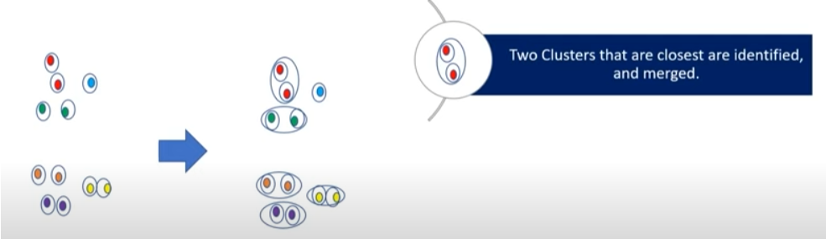

Slide 20
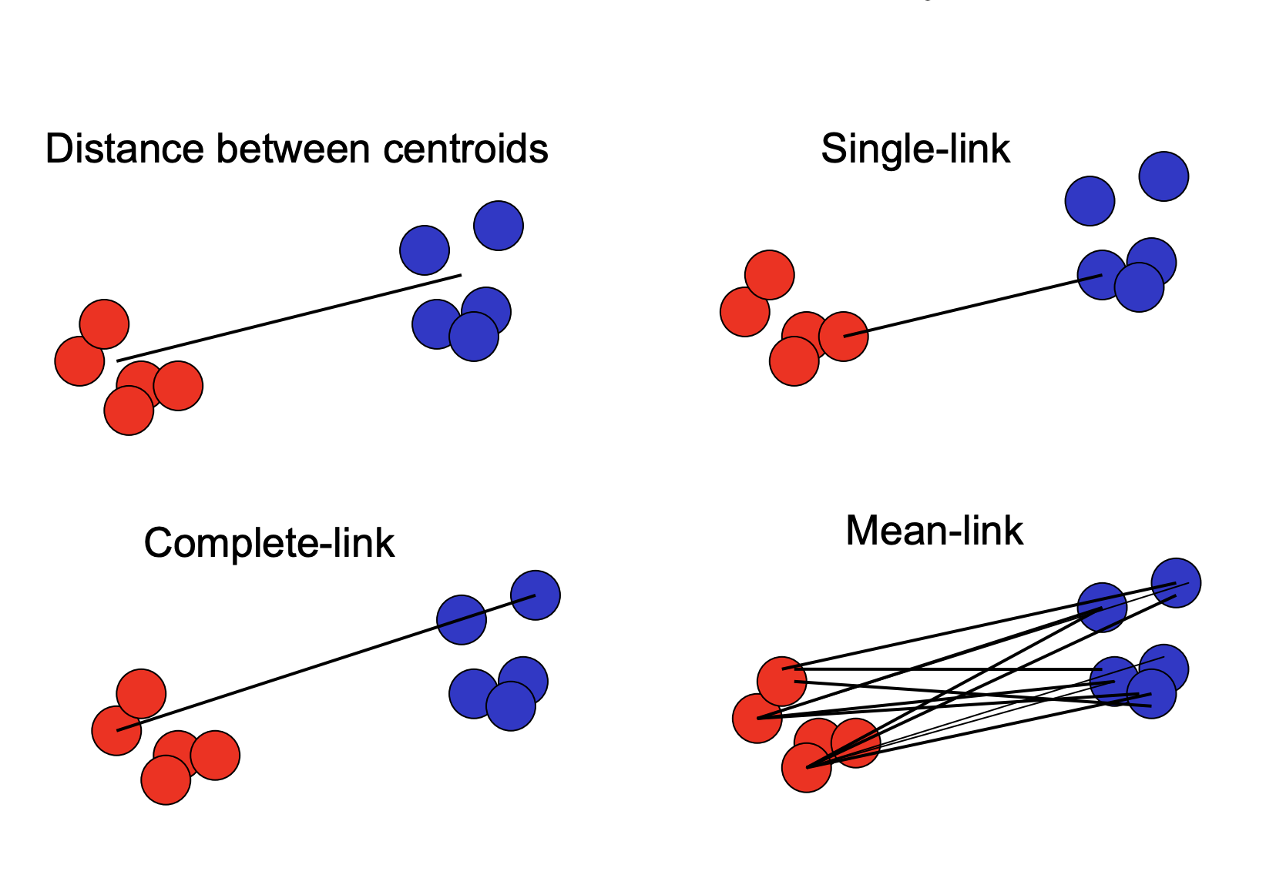
All linkage methods

Slide 21
Let us work on simple example

Slide 22
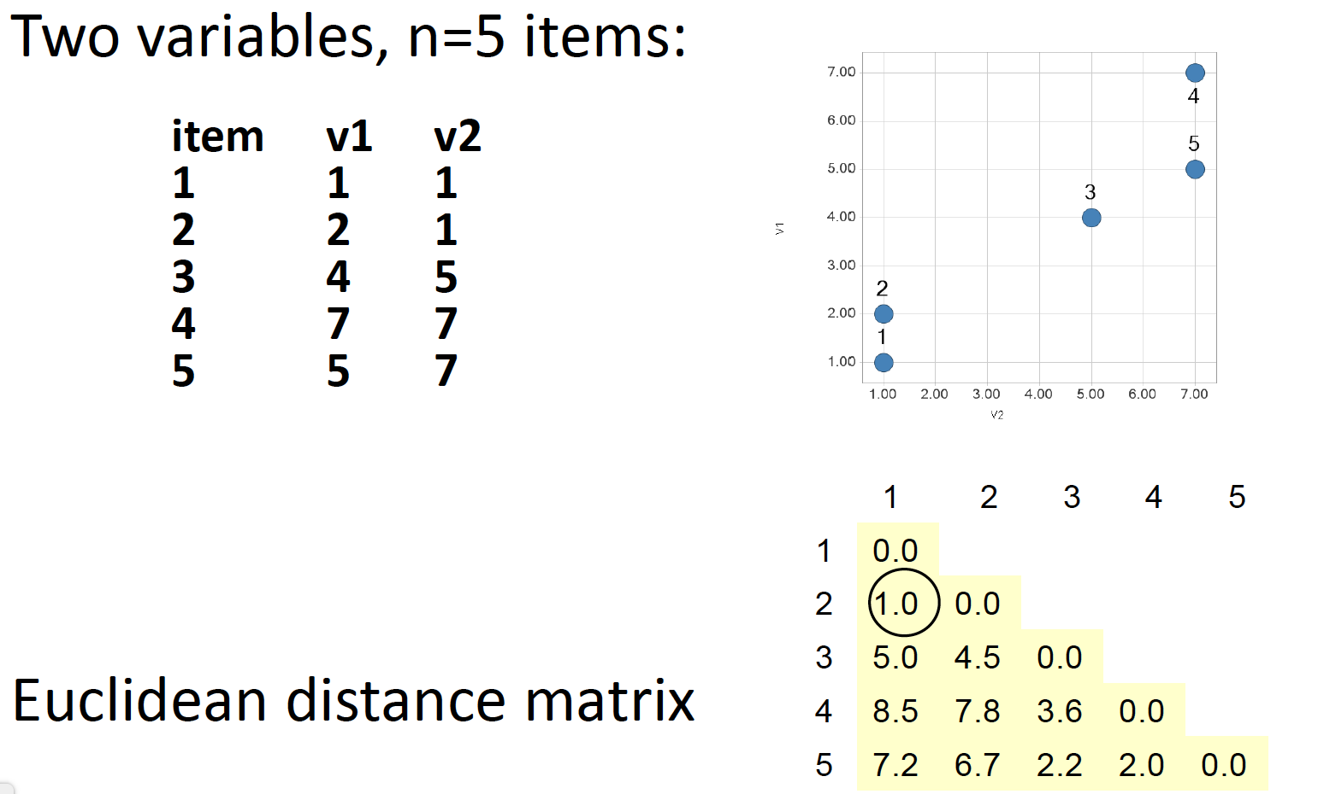

Slide 23
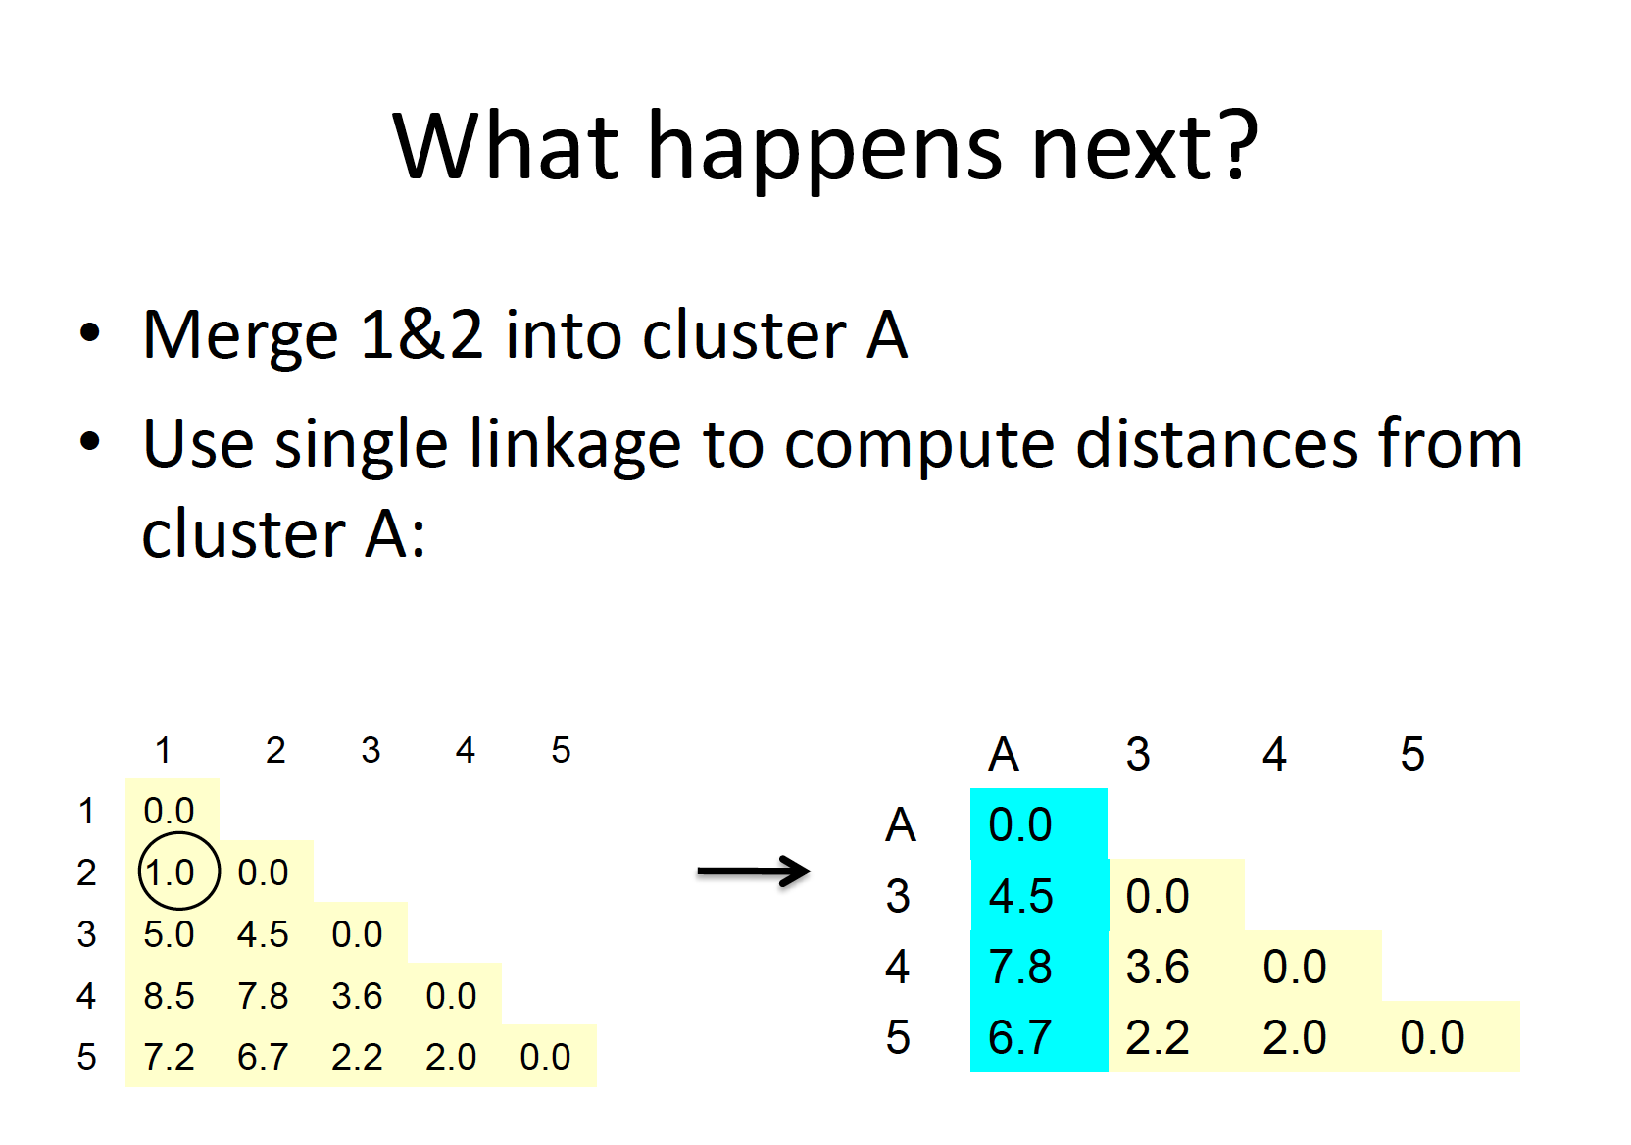

Slide 24
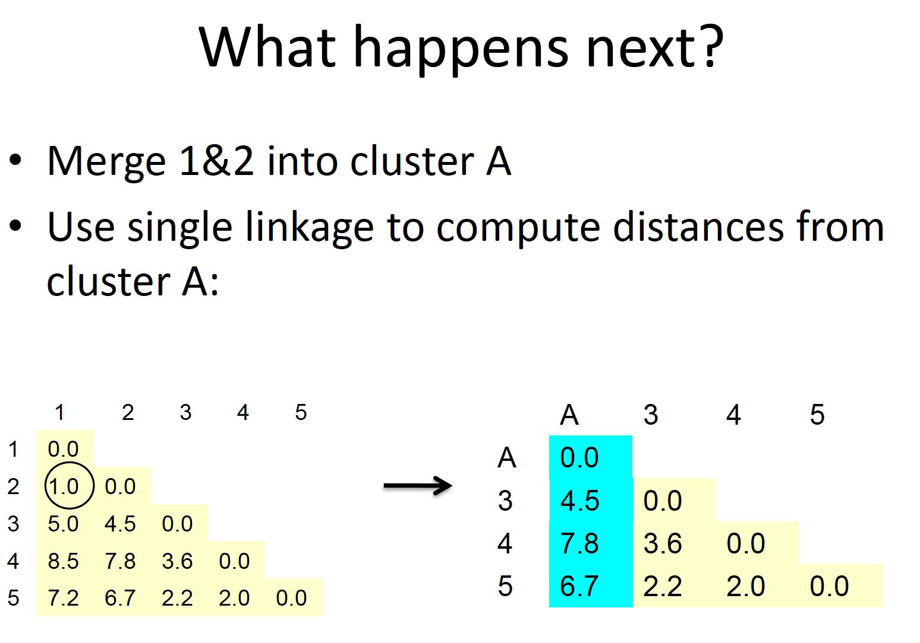

Slide 25
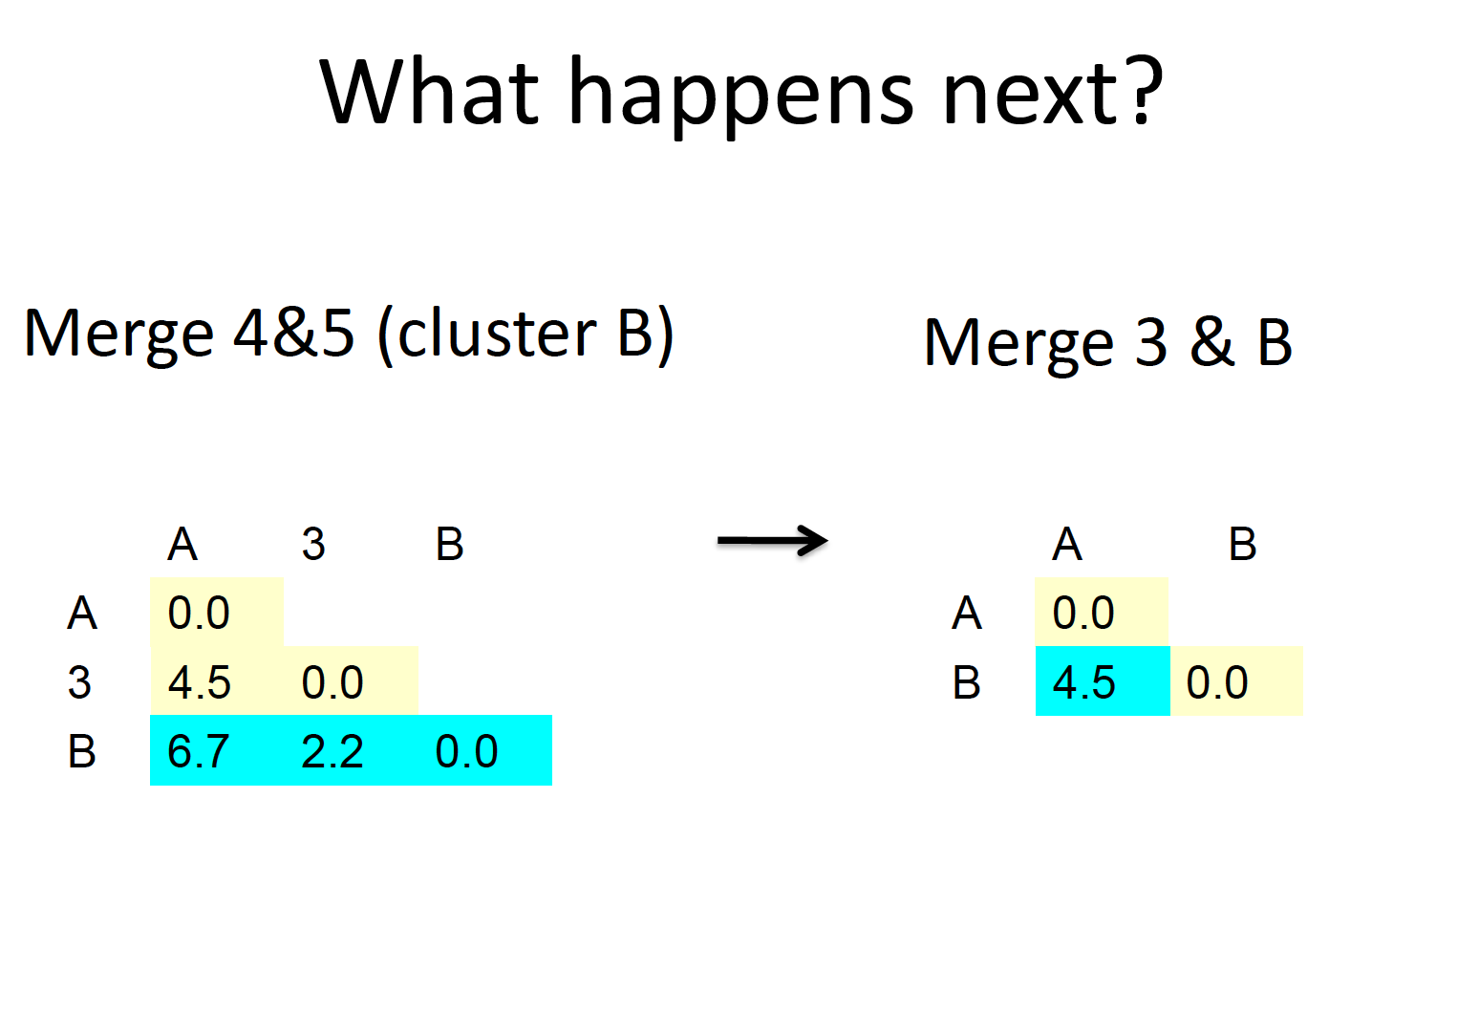

Slide 26
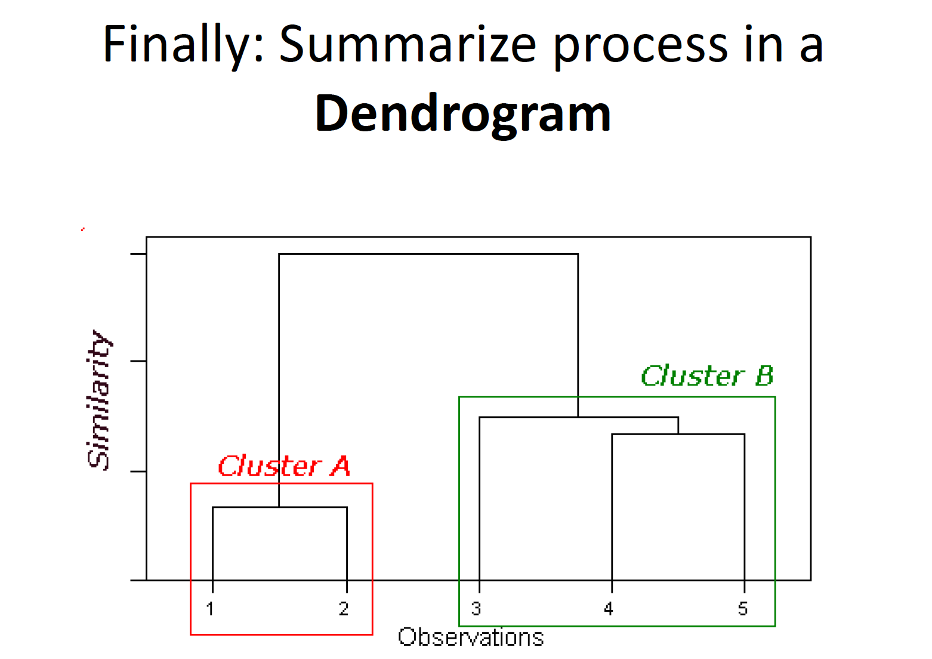

Slide 27
University Data set

Slide 28
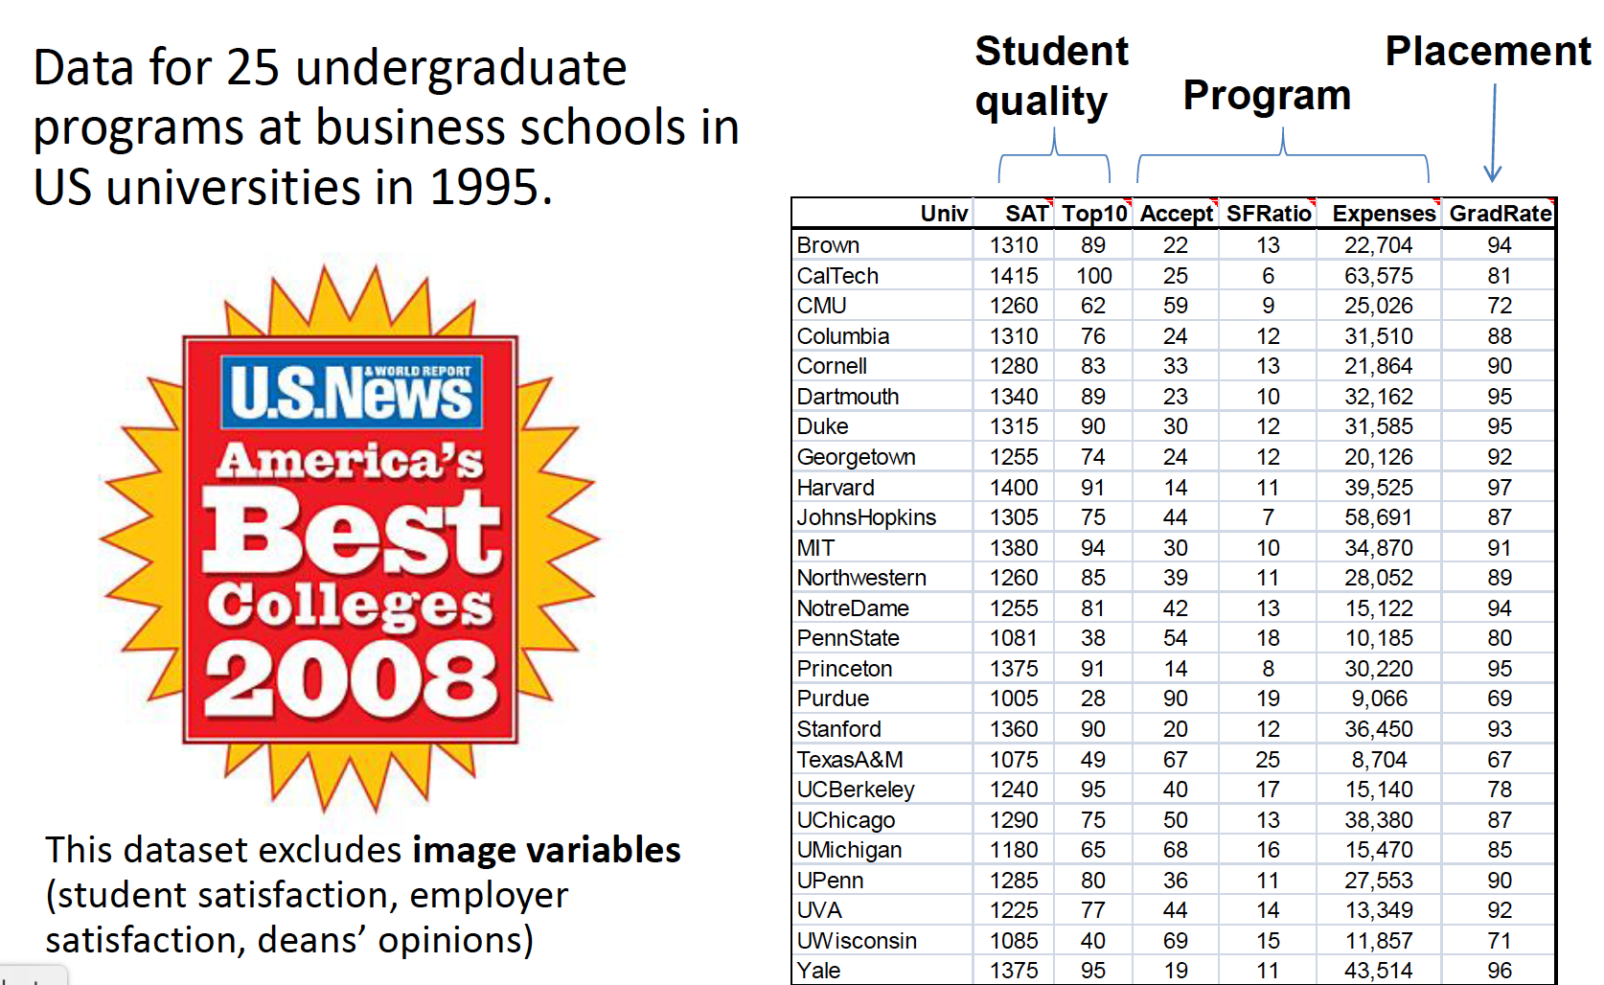

Slide 29
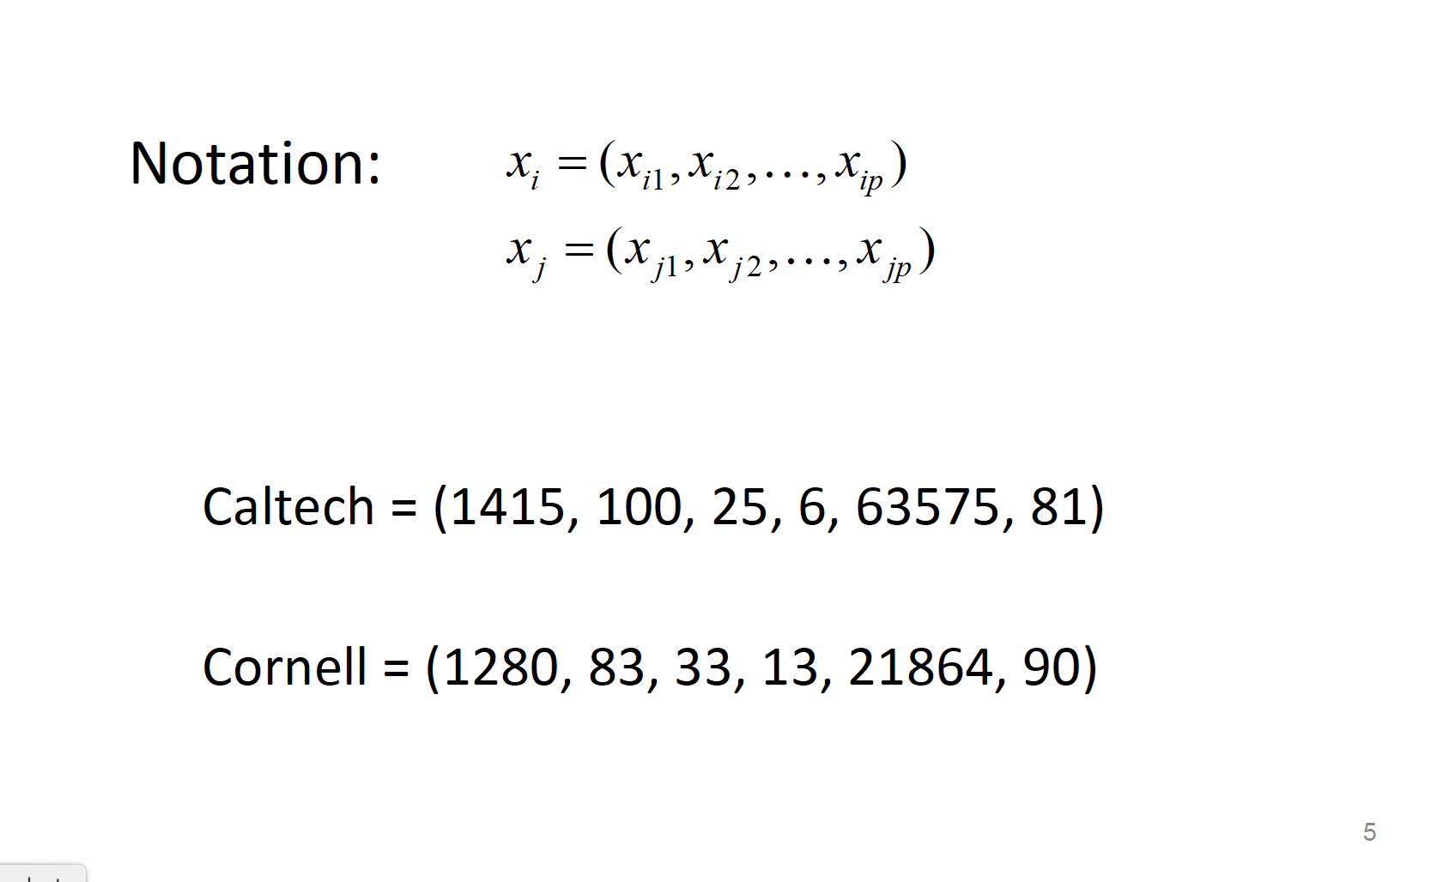

Slide 30
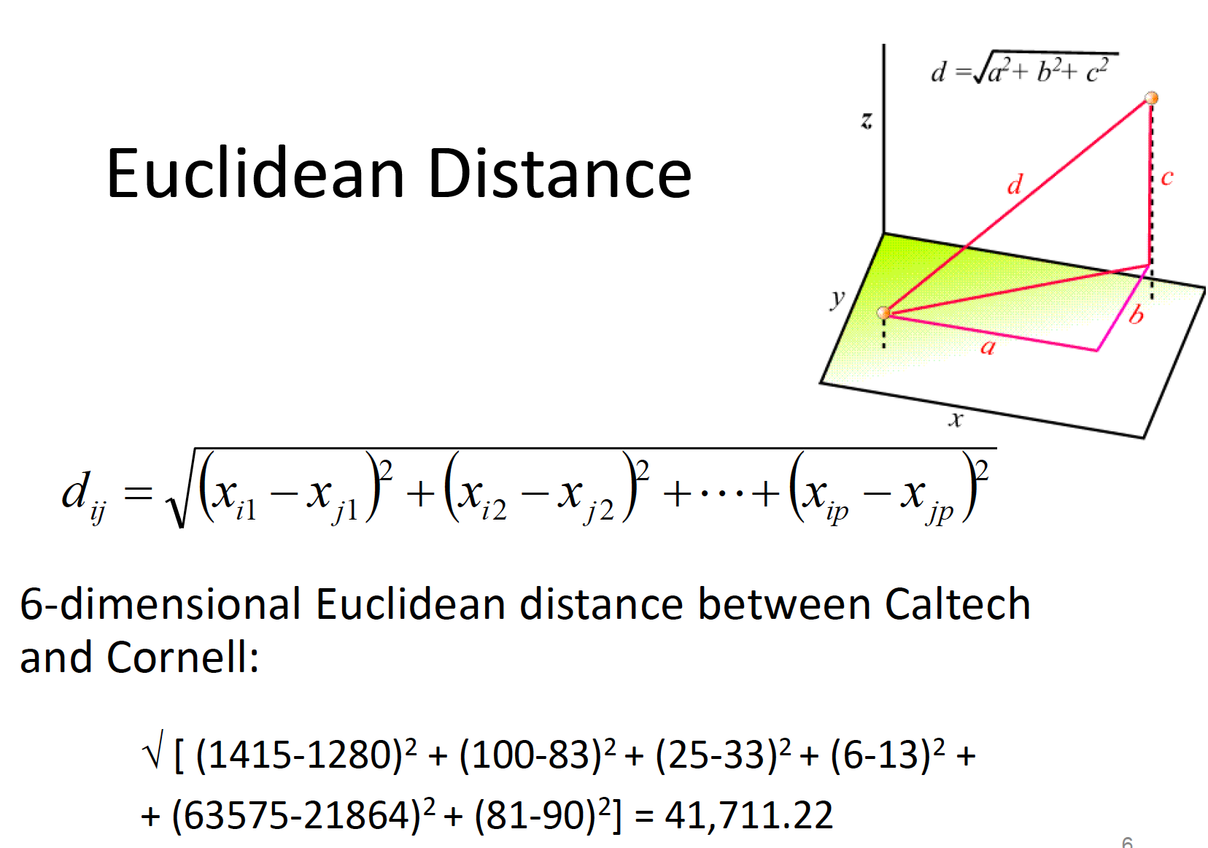

Slide 31
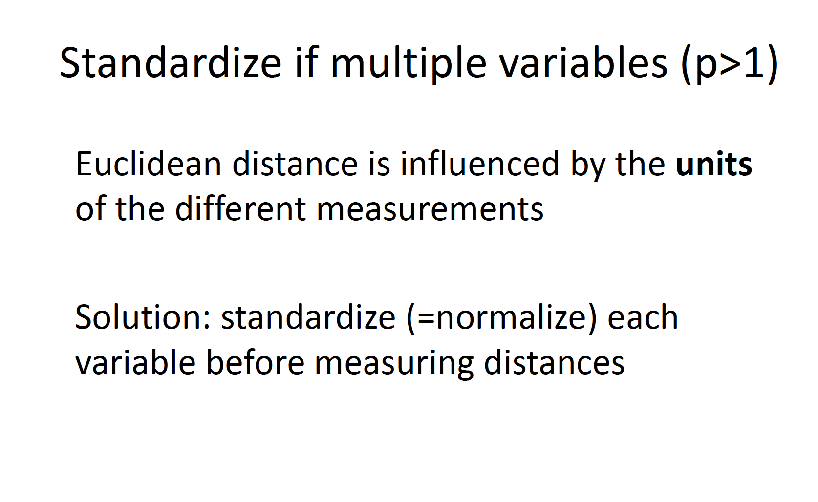

Slide 32
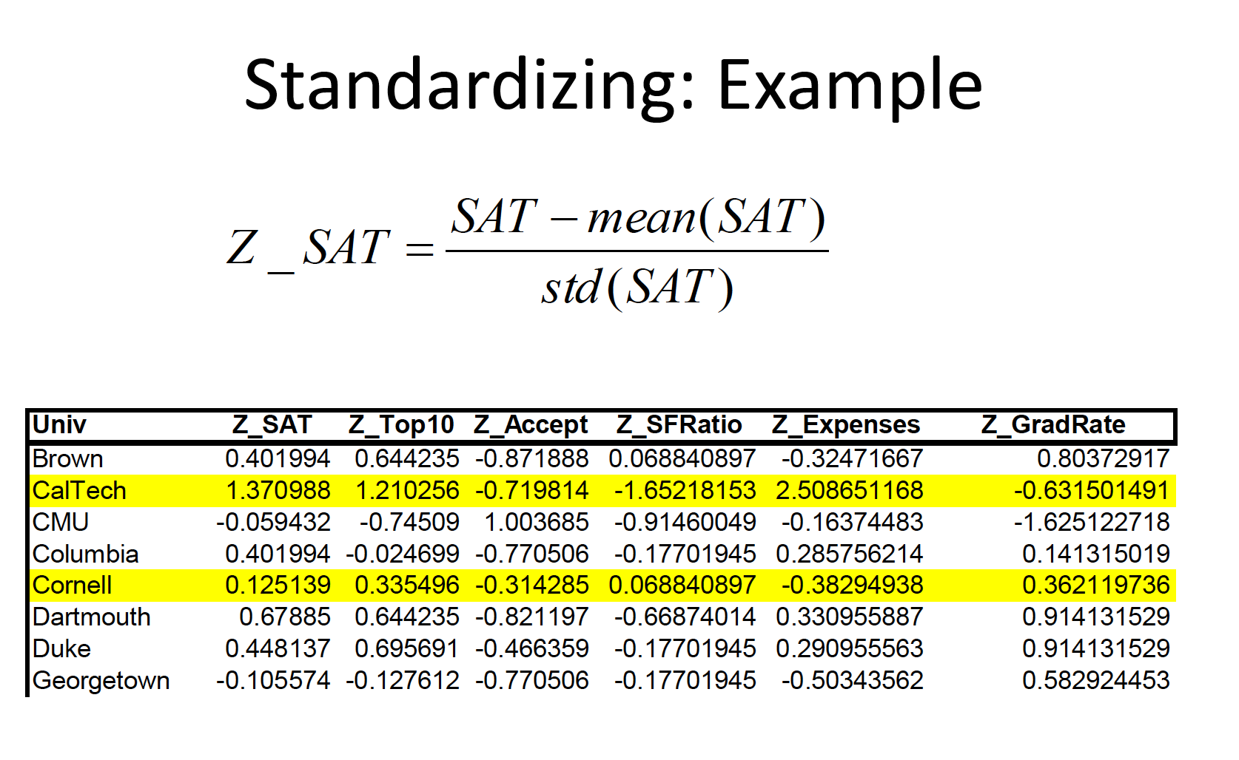

Slide 33
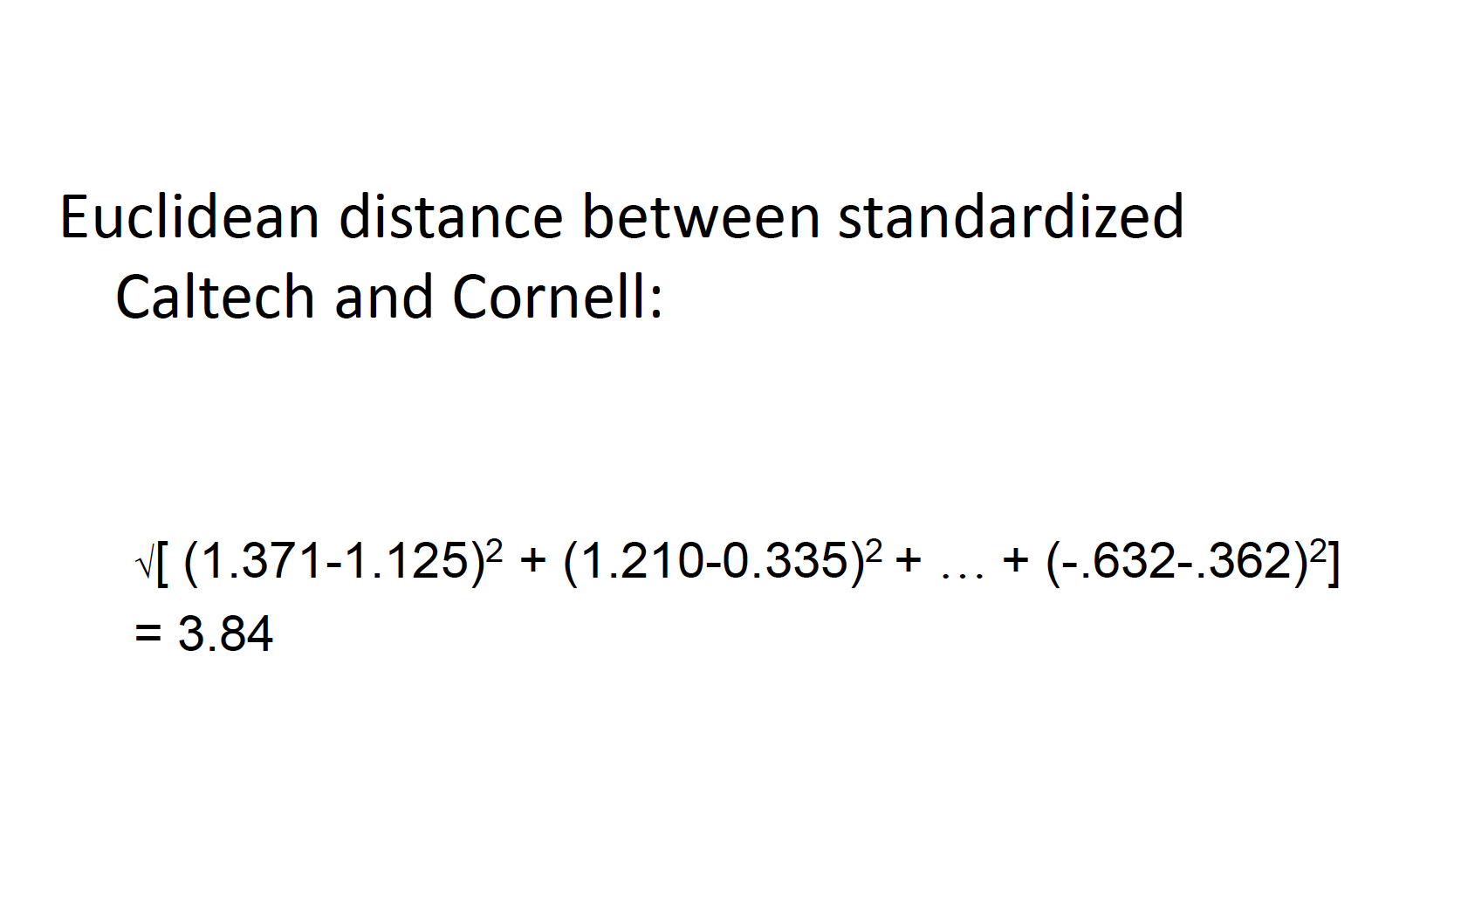

Slide 34
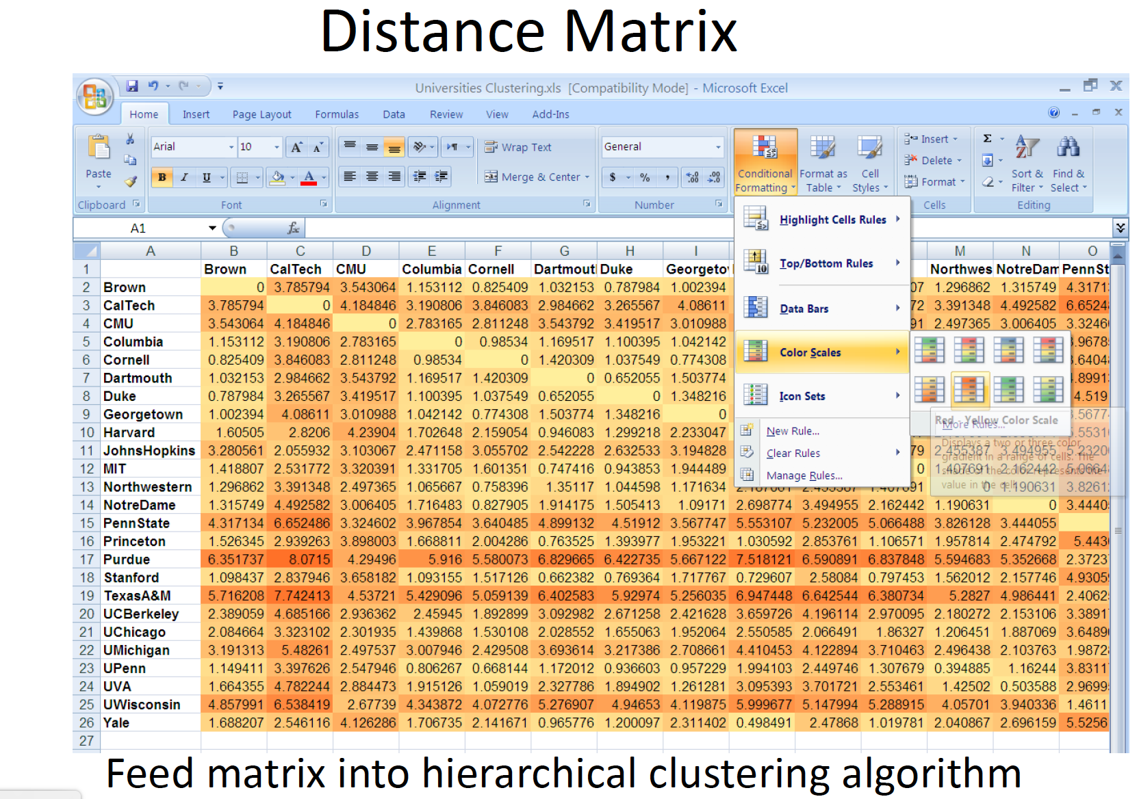

Slide 35
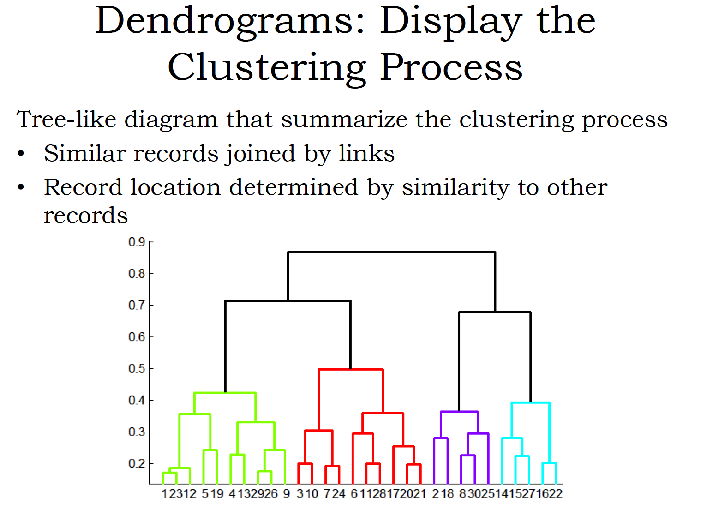

Slide 36
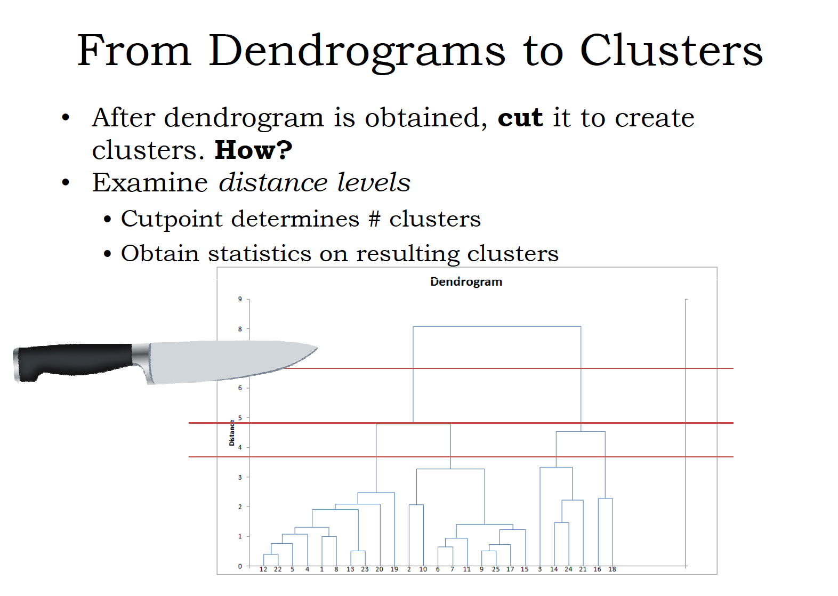

Slide 37
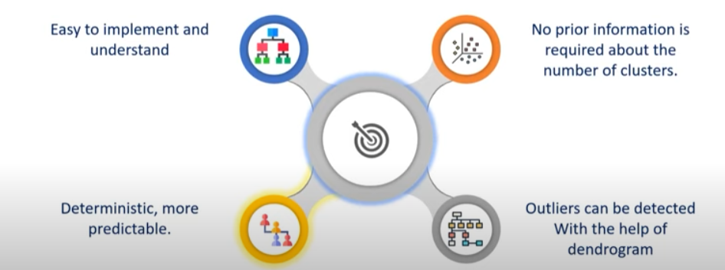
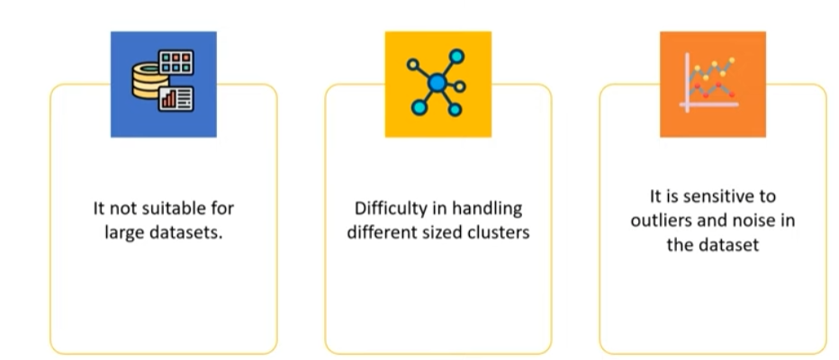
Advantages of Hierarchical Clustering
Disadvantages of Hierarchical Clustering

Slide 38
Thank you

